Slide 1


Pilot Project – Instagram Tech Influencer Account Analysis
Using SQL
Domain : Social Media Analytics
Problem Statement
This project focuses on analysing the social media performance of a tech influencer’s Instagram account. The analysis is based on three key database tables that capture detailed activity metrics over a 9-month period (January to September).
The objective is to explore, interpret, and visualize this data to uncover patterns in engagement, posting behaviour, and audience interaction ultimately providing actionable insights to help optimize content strategy and growth performance.
This Analysis is part of my Data Analyst virtual Internship at AtliQ Technologies (by Codebasics)
By Dheeraj

Slide 2
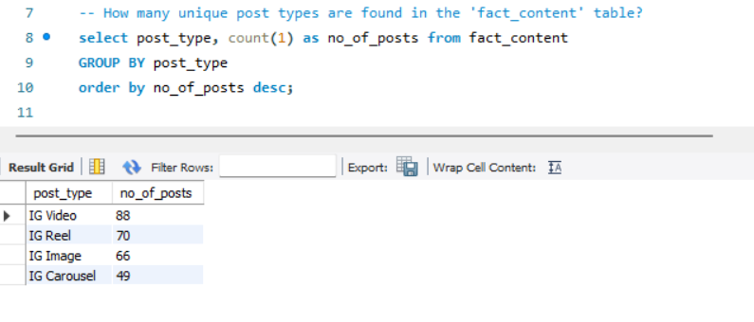
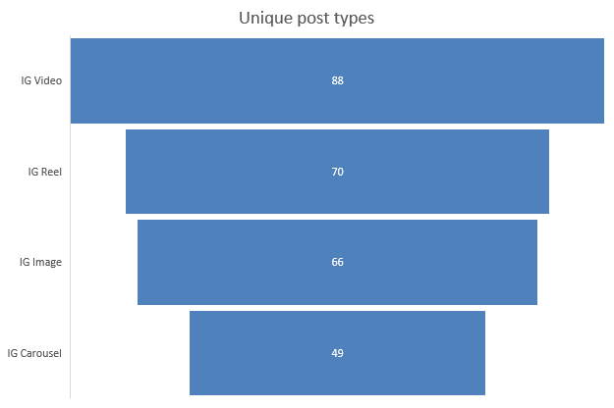
This Analysis Includes 3 database tables
dim_date : This covers all date and time related attributes
fact_account : This has account details of the influencer like profile visits and followers by date
fact_content : This has what type of content is delivered and its engagement ( likes, views etc..
Let’s begin with the Analysis ….
1. How many unique post types are found in the 'fact_content' table?

Slide 3
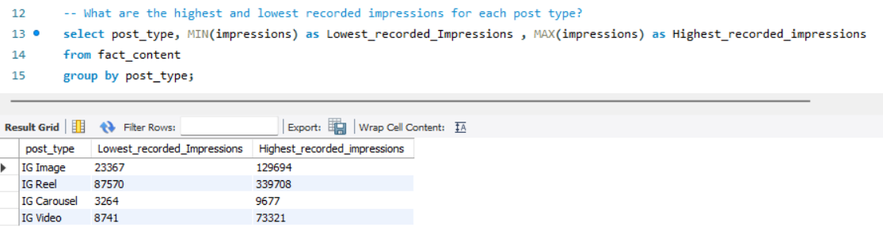
2. What are the highest and lowest recorded impressions for each post type?

Slide 4
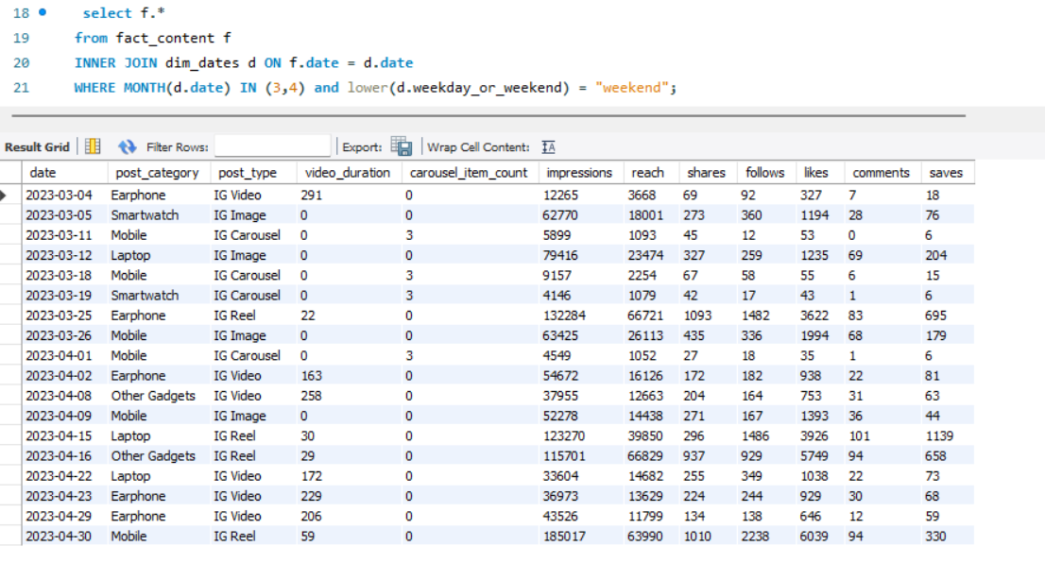
3. Filter all the posts that were published on a weekend in the month of March and April and export them to a separate csv file.

Slide 5
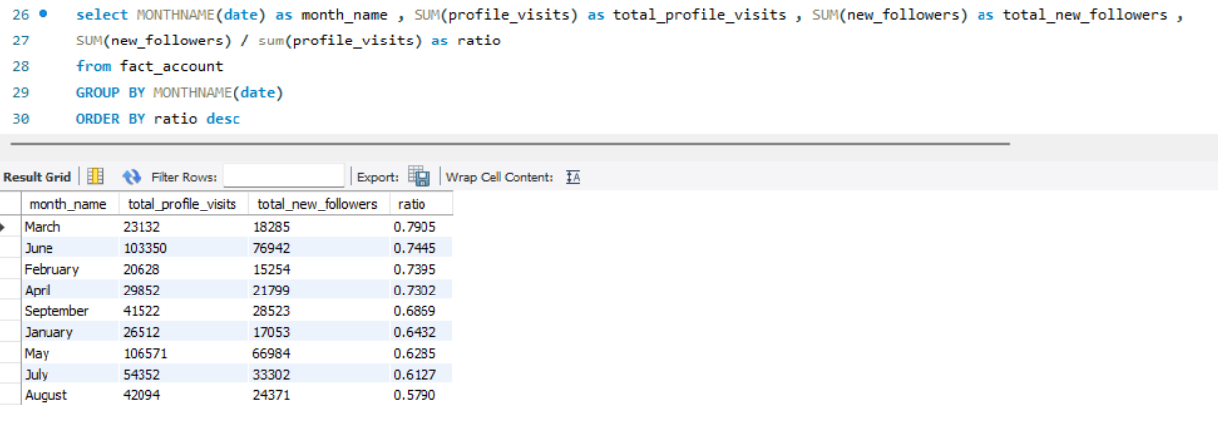
4. Create a report to get the statistics for the account.
The final output includes the following fields: month_name, total_profile_visits, total_new_followers
Here the Ratio ( Follower Conversion ratio) = New Followers / Total profile Visits
Interpretation:
A high ratio means most profile visitors liked the content and decided to follow strong content appeal and relevance.
A low ratio indicates that visitors are interested enough to view the profile but not compelled to follow suggesting a need to improve content resonance or call-to-action.
Observation from my analysis:
Among all months, March showed the highest conversion ratio, meaning the influencer’s content during that month was most effective in converting visitors into followers possibly due to diverse and engaging posts across multiple categories.

Slide 6
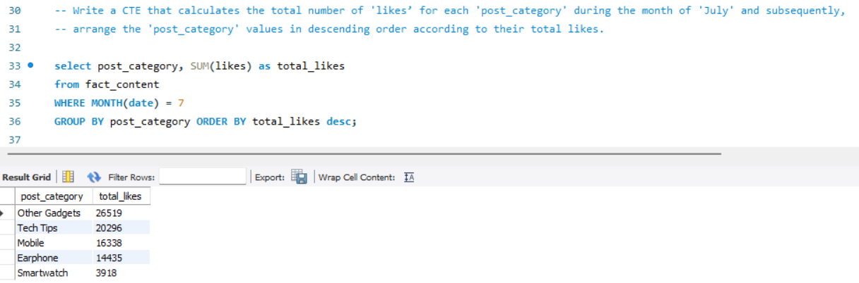
5. Write a CTE that calculates the total number of 'likes’ for each 'post_category' during the month of 'July' and subsequently,
arrange the 'post_category' values in descending order according to their total likes.

Slide 7
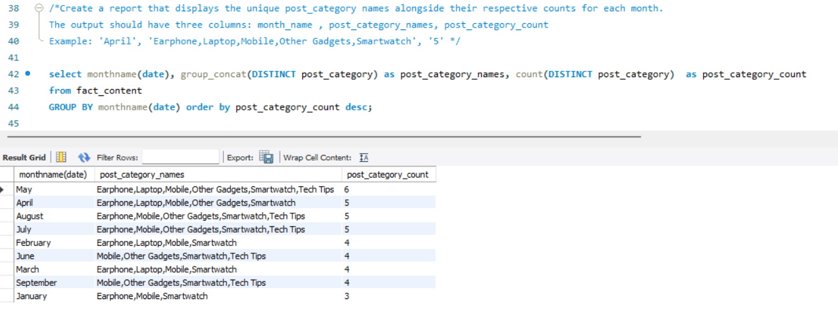
6. Create a report that displays the unique post_category names alongside their respective counts for each month.
The output should have three columns: month_name , post_category_names, post_category_count

Slide 8
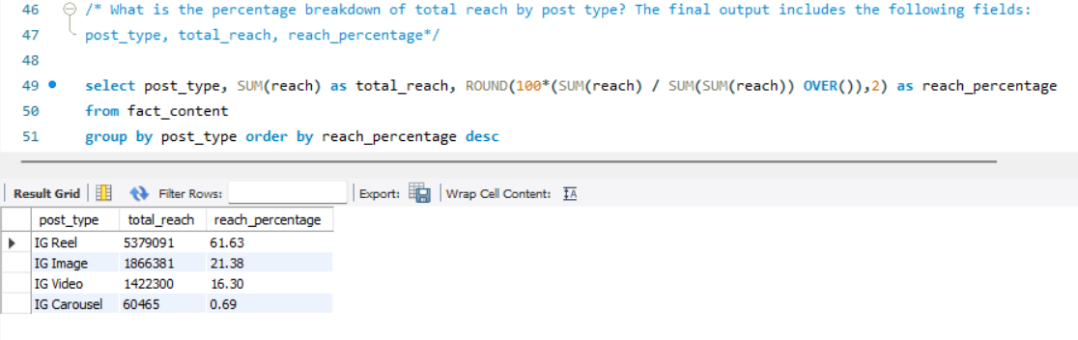
7. What is the percentage breakdown of total reach by post type?
The final output includes the following fields: post_type, total_reach, reach_percentage

Slide 9
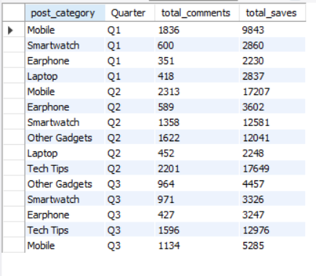
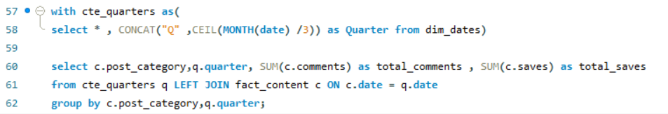
8. Create a report that includes the quarter, total comments, and total saves recorded for each post category.
Assign the following quarter groupings:(January, February, March) → “Q1” (April, May, June) → “Q2” (July, August, September) → “Q3”
The final output columns should consist of: post_category,quarter,total_comments,total_saves

Slide 10
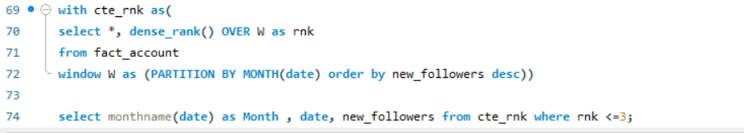
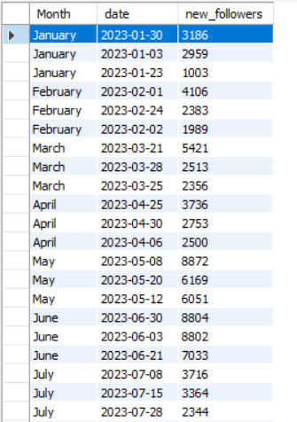
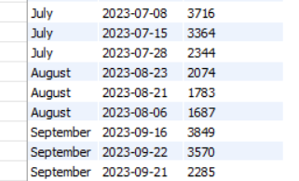
9. List the top three dates in each month with the highest number of new followers.
The final output should include the following columns:month,date,new_followers

Slide 11
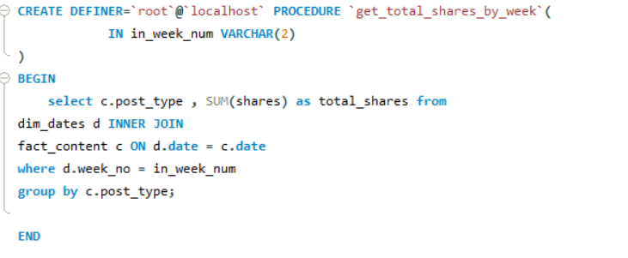
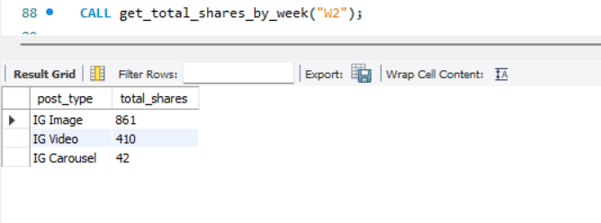
10. Create a stored procedure that takes the 'Week_no' as input and generates a report displaying the total shares for each 'Post_type’.
The output of the procedure should consist of two columns: post_type , total_shares

Slide 12
Key Insights & Recommendations
Insights
Reels dominate performance by contributing ~62% of total reach, followed by Images (22%).
May - June showed the highest engagement and new followers, driven by diverse, multi-category content.
Follower Conversion Ratio (New Followers ÷ Profile Visits) peaks in March, showing that content strongly resonated and converted visitors into followers.
Top-performing categories: Tech Tips , Mobiles and Other Gadgets
Tech Tips posts have the highest number of saves, indicating strong educational and long-term engagement value.
Engagement dropped from July to September, suggesting reduced posting consistency or less relevant themes.
Recommendations
Prioritize Reel content, especially around Tech Tips, Mobiles and Gadget Demos, to maximize visibility and conversions.
Maintain diversity in content categories combining Mobiles, Smartwatches, Laptops, and Gadgets improves reach and follower growth.
Use the Follower Conversion Ratio as a monthly KPI to evaluate content effectiveness and audience interest.
Reproduce strategies from high-conversion months (May–June) such as frequent posting and broader category coverage.
Explore Carousel posts for tutorials and comparisons to drive more saves and shares.
Analyse posting frequency and timing to identify patterns that boost reach and engagement.
Thank you

